Slide 1
Substation AI Compliance Assistant
CSE7101- Capstone Project
Review-5
Batch Number: CSE_69
Under the Supervision of,
  Mr.Laxman
  Professor of Practice
  School of Computer Science and Engineering
  Presidency University
Roll Number | Student Name
20221CSE0295 | Shreeansh Sachan
20221CSE0159 | Raj Prasad Singha
20221CSE0148 | Aditi Pravin Nimje
Name of the Program: Bachelor of Technology
Name of the HoD: Dr. Asif Mohamed H B
Name of the Program Project Coordinator: Dr. Jayavadivel Ravi
Name of the School Project Coordinators: Dr. Sampath A K , Dr. Geetha A

Slide 2
Problem Statement Number: PSCS_67
Problem Tittle: Intelligent Chatbot for Substation Asset Maintenance
Organization: Ministry of Power
Category : Software
Problem Description:
Substation maintenance relies on vast, fragmented manuals for complex equipment procedures.
This makes it difficult for technicians to quickly find and utilize critical information.
Current keyword-based searches lack semantic understanding, leading to imprecise and irrelevant results.
Technical documentation uses specialized jargon and complex structures, posing significant NLP challenges.
Critical data like "acceptable limits" are often dispersed or missing, hindering accurate decision-making.
An intelligent chatbot is needed to provide precise, context-aware answers, integrating standards and safety.

Slide 3
Content
Problem Statement
Abstract
Literature Survey
Objectives
Existing methods and drawbacks
Modules
Architecture
Pseudocode(Frontend)
Pseudocode(Frontend)
Timeline
References

Slide 4
Problem Statement:
Problem Statement: Intelligent Chatbot for Substation Asset Maintenance
Current maintenance practices rely heavily on physical manuals, static PDFs, and on-site expert supervision. This can be inefficient and prone to human error.
Recent advancements in AI and NLP have enabled the creation of conversational agents (chatbots) for a variety of technical domains, but a dedicated solution for substation maintenance is a novel application.
Our project aims to bridge the gap between traditional maintenance methods and modern AI capabilities, providing a robust, accessible, and intelligent tool for technicians.

Slide 5
Abstract
The efficient operation of modern electric grids critically depends on meticulous maintenance of substation assets. This project proposes a novel intelligent chatbot system that addresses the significant knowledge gap in traditional maintenance strategies.
Problem: Manual information retrieval from fragmented textual documentation leads to inefficiency, increased downtime, and safety risks
Objective: Develop a hybrid AI architecture combining NLP, Knowledge Graphs, and safety logic
Approach: Fact-grounded system that ensures verifiable, traceable responses from technical documentation
Impact: Enhanced operational efficiency, improved safety, and regulatory compliance

Slide 6
Literature Survey
1.AI in Compliance (Ahmad & Khan, 2023): "Human-in-the-loop" AI systems can reduce compliance documentation time by up to 70% and improve safety governance.
2.NLP for Regulations (He et al., 2023): BERT-based models significantly outperform statistical methods in interpreting complex technical and legal language (e.g., equipment manuals).
3.Knowledge Graphs (Chen & Liu, 2022): Structured graphs are essential for mapping relationships between power system faults and specific regulatory standards.
4.Predictive Maintenance (Smith & Jones, 2022): The industry is shifting from preventive to predictive strategies, using AI to analyze condition monitoring data (vibration, oil analysis).

Slide 7
Objectives
Intelligent Conversational System: Design a chatbot that understands and answers complex regulatory questions using Natural Language Understanding (NLU).
Compliance Knowledge Engineering: Build a structured domain model covering Indian Electricity Rules, CERC, and IEC standards.
Automated Monitoring: Implement real-time compliance checks by integrating with substation operational systems.
Unified Platform: Create a "Single Source of Truth" for all regulatory updates and best practices.Documentation Automation: Auto-generate audit-ready reports to reduce manual administrative effort.

Slide 8
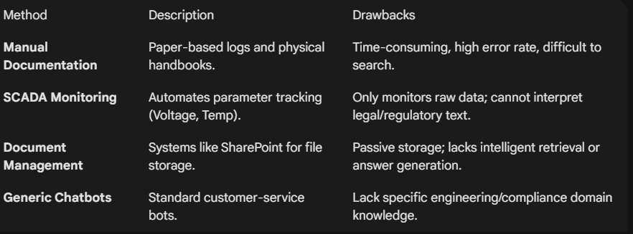
Existing methods and drawbacks

Slide 9
Module
Input Processing Module: Handles user queries (text/voice) via tokenization and intent recognition.
NLP Engine: Uses BERT models for semantic understanding of regulatory language.
Knowledge Base: A graph database (Neo4j) containing structured regulations (IEEE, IEC, CERC).
Compliance Analysis Engine: Compares real-time operational data against regulatory thresholds.
Risk Assessment Module: Predicts potential hazards and assigns risk scores.
Reporting Module: Generates visualizations and PDF compliance reports.

Slide 10
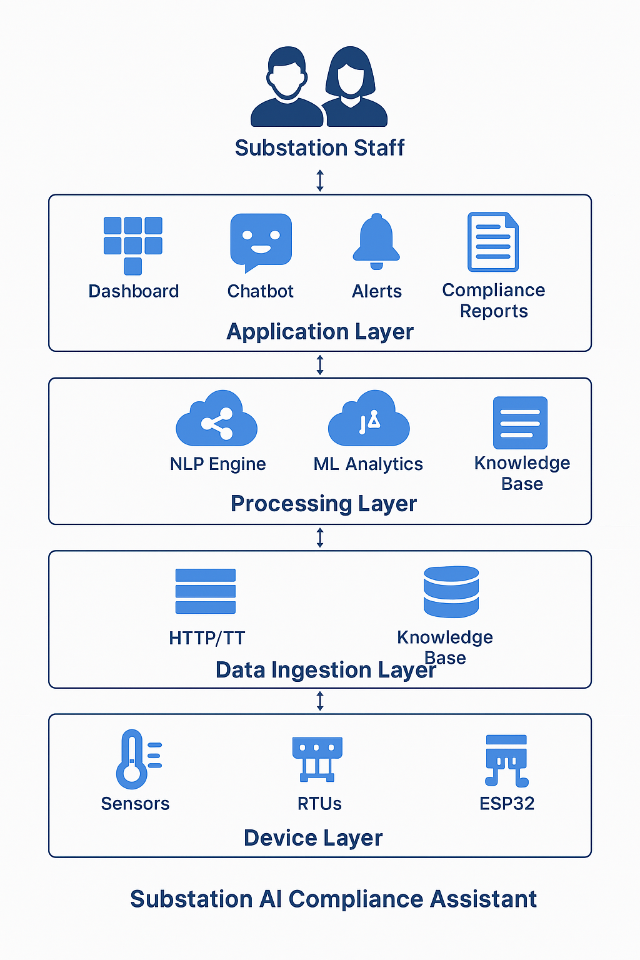
Architecture

Slide 11
Pseudocode(Frontend)
FUNCTION HandleUserQuery(userInput):
IF userInput is EMPTY:
RETURN "Please enter a question."
// Step 1: Display user message in Chat UI
RenderMessage(userInput, "User")
// Step 2: Send query to Backend API
TRY:
response = AWAIT Fetch("/api/query", {
method: "POST",
body: { text: userInput }
})
data = response.JSON()
CATCH Error:
RETURN "System Error: Unable to reach compliance server."
// Step 3: Process and Display Response
IF data.status == "Success":
// Show the answer with citations
RenderMessage(data.answer, "Bot")
// Update Dashboard if response includes live metrics
IF data.metrics:
UpdateDashboard(data.metrics.voltage, data.metrics.temp)
// Show Safety Precautions if high risk
IF data.risk_score > 50%:
ShowAlert("Warning: High Compliance Risk detected!")
ELSE:
RenderMessage("I couldn't find a regulation matching that query.", "Bot")
END FUNCTION

Slide 12
Pseudocode(Backend)
CLASS ComplianceBot:
INIT:
Load knowledge_base FROM "equipment_data.json" [cite: 710]
FUNCTION FindEquipment(user_query):
normalized_query = user_query.to_lower()
FOR item IN knowledge_base:
# Check exact name, acronyms (e.g., GIS), or aliases [cite: 673]
IF item.name IN normalized_query OR item.acronym IN normalized_query:
RETURN item
RETURN Null
FUNCTION ProcessChat(user_query):
# Step 1: Entity Extraction
equipment = FindEquipment(user_query) [cite: 691]
IF equipment IS Null:
RETURN "Equipment not recognized."
# Step 2: Intent Classification & Response Generation [cite: 695-703]
IF "tool" IN user_query:
result = equipment.tools
ELSE IF "maintain" OR "prevent" IN user_query:
result = equipment.preventive_maintenance
ELSE IF "safety" OR "precaution" IN user_query:
result = equipment.safety_precautions
ELSE IF "fail" OR "symptom" IN user_query:
result = equipment.failure_symptoms
# Step 3: Return Response with Random Confidence Score [cite: 696]
RETURN FormatResponse(result, confidence_score)

Slide 13
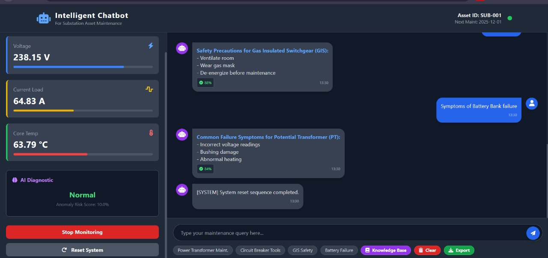
PROTOTYPE SNAPSHOT
cm

Slide 14
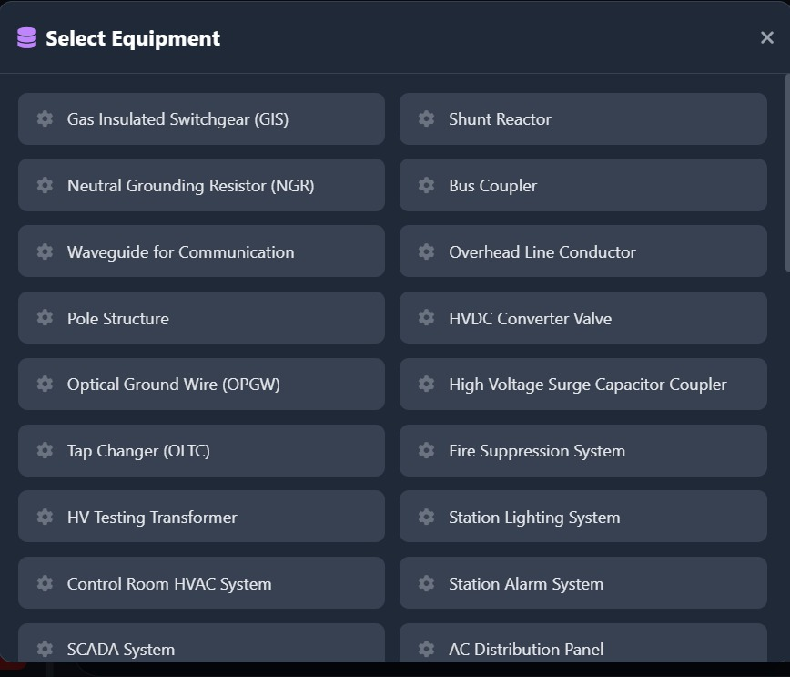

Slide 15
PROJECT LINKS
GITHUB LINK:
  https://github.com/codedbyaditi/substation-

Slide 16
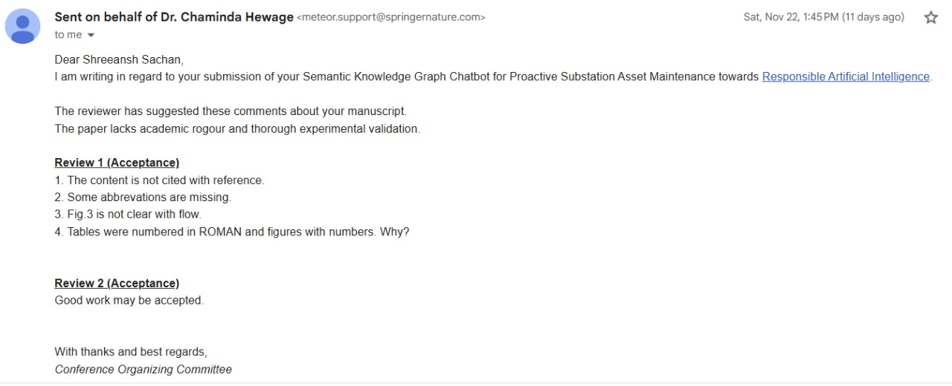
Publication

Slide 17
References (IEEE Paper format)
Ahmad, F. & Khan, J. (2023). Ethical and Safety Implications of AI Deployment in Critical Energy Systems. Energy Policy Journal.
He, T., et al. (2023). BERT-BiLSTM-CRF for Named Entity Recognition in Complex Industrial Equipment Manuals. Journal of Applied ML.
Chen, Y. & Liu, P. (2022). Knowledge Graph Construction and Reasoning for Power System Fault Diagnosis. IEEE Transactions on Power Systems.
Smith, A. & Jones, B. (2022). The Transition from Preventive to Predictive Maintenance in Smart Grids. Journal of Power Engineering.

Slide 18
THANK YOU

